Slide 1
Using Statistics Bureau Japan Data at an Onsite Facility -Perspectives of New Dara Sources from Japanese Official Statistics-
9th Jan. 2020
Hiroe Tsubaki, Mayumi Oka and Motoi Okamoto
The Institute of Statistical Mathematics
Notes:
Thank you very much for your kind introduction.
Today I’d like to introduce general perspectives of new data sources of Japanese official statistics
in big data era.

Slide 2
CONTENTS
Ⅰ Big data era in Official Statistics
Ⅱ Utilization of New Input
Ⅲ Production of New Output
Ⅳ What we can do in an Onsite Facility
Ⅴ Conclusion
Notes:
This slide shows the contents of my presentation.
In my presentation I will introduce two types of new data sources.
One is the new input data source for Japanese official statistics
and another is new output data source from Japanese official statistics.
Before I introduce the recent topics of new inputs and outputs of Japanese official statistics in big data era,
I’d like to show my opinion on the big data era.

Slide 3
Ⅰ Big Data Era in Official Statistics
Role of Statistician for Data Industrial Revolution
New Way: The Expansion of Data Sources for the Official Statistics
New Mission: The Social Needs of new data sources from Official Statistics
Notes:
At first I would like to summarize general roles of statisticians in big data era
that lead to New ways and New mission of Official statistics as shown this slide.

Slide 4
１ Role of Statistician for Data Industrial Revolution
Prof. Hal Varian
Commentary 2009/01 McKinsey & Company
“The ability to take data – to be able to understand it, to process it, to extract value from it, to visualize it, to communicate it – that’s going to be a hugely important skill in the next decades.”
“Because now we really do have essentially free and ubiquitous data. So the complimentary scarce factor is the ability to understand that data and extract value from it”
Notes:
Professor Hal Varian, Google’s chief economist said
“the sexy job in the next ten years will be statisticians” 10 years ago.
His remarks became very famous because the New York times picked it up.
But in my opinion, his justification is much more important.
In fact the cost of data and its analysis has drastically decreased
so the set of competences that characterized a statistician is going to be a hugely important skill now.

Slide 5
１ Role of Statistician for Data Industrial Revolution
Value expected from Official Statistics
Exploratory Data ;Analysis:
Gap Analysis for Problem Finding
Specific Observation,
Experiment
& Interview on
What, Who, When, Where & How
Visualization
Check
Gap between requirements and realities; What, Who, When, Where, How
Action
Solution
Plan
Implementation Plan of the Optimized Solution
Do Evidence based
Process Control
Solution Strategy
Collecting Information
from “Gemba”
Analysis and Synthesis
Conclusion
Plan for Solution
Problem
Finding
Cycle for Problem Solving
Daily Management Cycle
Confirmatory Data Analysis
& Optimization
Deming-Ishikawa’s PDCA (CAPDo) Cycle for Management and Improvement
Quantitative and Qualitative Cause and Effect Analysis
Notes:
Here I will show you my interpretation and appreciation to PDCA cycle and Standardized Problem Solving Scenario,
which generally clarifies how to create social value by statisticians.
If some one notice some non-ignorable gap between expectation and observation in the Check phase of PDCA,
it shall be a trigger to start the other cycle for problem solving,
so Check in PDCA and finding problem in the second cycle
are in a sense simultaneously occurred.
Next phase to decide solution strategy may not use quantitative tools,
but I believe
this inductive thinking stage using expert knowledge may be the most essential part of problem solving.
After the Solution Strategy phase,
they will collect the necessary information systematically.
And they will also analyze the collected information maybe statistically.
Then they can get the plan to optimized solution in conclusion after some confirmatory observation,
and finally they can return to the Action and Plan phases of their daily management
into which the solution is concretely implemented.
I would personally recommend that
the government should utilize official statistics more actively and systematically,
particularly for the social problem finding phase,
by detecting significant regional or temporal differences relevant with potential social risk.

Slide 6
１ Role of Statistician for Data Industrial Revolution
Data Driven Consultation as a New Industry
Value Chain along Data Processing
Data Driven (Evidence Based ) Policy Making
New Way and Mission of Official Statistics Division
Conceptual Diagram of the Value Chain
①
Data Collecting Economically such as Data Scraping
②
Data Curating Efficiently
&
Decision based on Visualized Data
③
Data Linkage and Analytics: Modelling, Mining or Machine Learning
④
Decision based on Predictive Data Analysis
Official Statistics as Social Foundation of Data Industry
Notes:
Nowadays not only professional statisticians,
but also data driven consultation industry shall benefit from great economic value creation from big data.
In fact we can certainly enjoy the value of data visualization
through big data collecting and curating for effective decision making.
We may also enjoy the economic value of prediction of our future life from the strategic data analyses.
Not only private industries but central or local governments should attend the activities on this data driven revolution.
Anyway,
this is my basic assessment of the big data era
that leads to a new way and mission for official statistics.
The new ways mean how to utilize new inputs along this value chain
in order to attain quality and excellence of our official statistics,
and
the new missions shall be acceleration of this data driven value creation by our outputs.
So ｍy presentation should be divided in two parts.
The first part is when using big data as input for our new ways.
The second part is to make official statistics the input to the big data society for our new mission.

Slide 7
２ New Way: The Expansion of Data Sources for the Official Statistics
Resource of data（Statistical data)
Past: Official Survey results only
Present: Existence of Big Data
(incl. various private sector data)
Official statistics requires the utilization of Big Data
Because of :
・Deterioration of the official survey environment
・Timeliness of private sector data
Notes:
For the input for official statistics for the new way,
a lot of similar private data are available from access panel or web scraping nowadays.
And there is a need to use this type of big data for official statistics.
In fact the survey environment of official statistics is getting worse and non-responders have also increased unfortunately,
while it is quite difficult to increase the sample size due to restrictions on the statistical budget.
Therefore,
in order to maintain and improve the accuracy of official statistics,
it is necessary to consider using corresponding private big data.
Unlike public statistical data, private big data is normally observed at all times.
If we can establish a method to utilize private data for formulating public statistical data,
it may be possible for users of the private data to obtain timely and unbiased information.

Slide 8
3 New Mission: The Social Needs of new data sources from Official Statistics
Provision of New Statistical results
・Statistical software (easy use)
& Many kinds of Data
・Users want to analyze data by themselves
Official statistical agencies are expected to provide
・Micro Data (Raw Data)
・Easier use of Survey results
・Statistical training
Notes:
The other case is when the official statistical survey itself is part of big data for our new mission.
But the demands of users of industry, academia might be so different, respectively.
For example,
researchers want to analyze micro data by themselves
while industries want to access macro data from our survey more easily,
We shall be not only preparing official statistics but also responding to these diverse needs.

Slide 9
Ⅱ Utilization of New Input
1 Utilization of POS data
2 New challenge of utilization of Big Data
※ POS data
The data shows Point of Sales which include the information such as “what” , ”when” , ”where”, “how match” and ”how many” commodities or service were bought.
Notes:
Now I will introduce a few cases of new inputs for our new ways,
those are POS data and other big data.

Slide 10
1 Utilization of POS data
The objects of POS data are limited. The close inspection about the characteristics of the data and about the utilization are required in the official statistics.
Official Statistic
Monthly
Consumer Price Index (Base 2015, 3commodities）
Private sector’s Statistics
Weekly: 2014/09~
SRI-Hitotsubashi Consumer Purchase Indices
Daily : 2013/05~
Nikkei CPINow
Notes:
Regarding POS data, it is already used as data for the calculation of consumer price index in Japan.
Currently, in the 2015 standard CPI announced at the of Statistics Bureau of Japan,
out of 585 items,
only three items, desktop personal computer, notebook computer, and camera, are calculated using POS data.
On the other hand,
there are weekly and daily price indices published by the private sector using POS data,
which is data showing sales performance of products.
If it is an indicator created by a specific private company,
there is no problem, even if they provide a price index by using specific data for a specific user.
On the other hand, in official statistics,
it is necessary to create indices that reflect the prices of the whole country unbiasedly.
Public statistics can not ignore areas, products and services that POS data does not cover.
In fact,
the private-sector price indices are partly judging their accuracy
in terms of the agreement or disagreement of the movement with our official CPI.
Therefore, even if private indicators exist,
the effectiveness and necessity of the official CPI as a standard does not decrease.

Slide 11

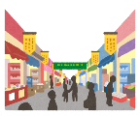




２ New challenge of utilization of Big Data
Conceptual Diagram of data sources of CTI
Two-or-more-person households
One-person
households
The new challenge of creating the “Consumption Trend Index (CTI)” is being considered by the Statistics Bureau of Japan.
Regarding data sources of the index, it is planned that not only official statistics but also private sector’s data including Big Data will be used.
Survey of
Household Economy
Monitoring survey
for
One-person household
Present:
Range of a result releasing every month
Family Income and
Expenditure Survey
Official
Statistics
Data
Commodity purchasing Survey
conducted by research company
Private
Sector’s
Data
POS data
electronic money, credit card, etc.
Big
Data
MEMBER’S CARD
BIGDATA
Harmonization of data sources is needed after bias correction.
Created by editing the workshop’s paper (Statistics Bureau of Japan)
(URL http://www.stat.go.jp/info/kenkyu/sss/pdf/161227_shiryou4.pdf)
Notes:
Now I would like to introduce our new challenge to utilize big data.
.
Here I briefly explain a new "CTI",
which is being developed rapidly by the Statistics Bureau,
based on the government policy.
Currently,
the monthly report of household consumption trends is limited to households with two or more people.
But mainly due to a decrease in the number of household members,
the consumption of two or more households in Japan is decreasing in the long term.
In addition, due to the increase in single households,
it is believed that divergence will occur in Japan
in consumption trends of two or more households and consumption trends in total households including single-person households.
So we need to incorporate the private statistical survey results and big data into the estimate of public statistics as possible,
and create new monthly indicators showing comprehensive and unbiased consumption trends.

Slide 12
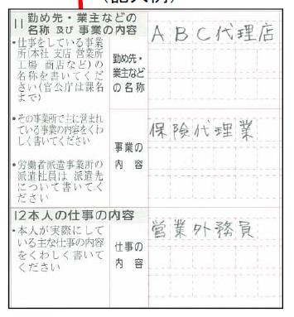
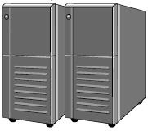

２ New challenge of utilization of Big Data
Various kinds of
expressions
Character
recognition
Ｊ（FINANCE
AND INSURANC）
D（Sales workers）
Support by ICT
Focusing on Difficult coding
Coding
rules
rules
Useful rules
generated by staff exploiting their expertise
Rules
generated by
machine learning
Notes:
Here
I will introduce a different type of activities for our new ways,
that is utilizing big data analytics in brief.
In the official statistical survey,
we ask the respondents to freely fill in the items purchased, their price, or company name.
In order to tabulate the information,
the staff of the statistics center daily converts the entered product name or company name into an appropriate code manually.
Although it is still in the research and development stage,
we are studying the implementation of auto-coding by machine learning methods.

Slide 13
Ⅲ Production of New Output
1 Macro Data Provision in Big Data Era
2 Different Micro Data Provision
Notes:
Next I would like to explain
possible new outputs from official statistics for Big data era for our new mission.

Slide 14
1 Macro Data Provision in Big Data Era
Provision of Macro Data for Potential User
Level of statistical users
Type of provision services
The level of
user request
③Statistical LOD
This data is provided for e-Stat users who need next-generarion data provision service.
e-Stat
Users
Advanced
②API function & jSTAT MAP
These functions are provided for mainly e-Stat users who use official statistics regularly but want to use them more conveniently .
Intermediate
①Statistics Dashboard
This system is provided mainly for beginners who want to use official statistics but never or hardly used them before.
Beginners
Range of users
※e-Stat is a portal site for Japanese Government Statistics.
Users can search and download statistical table freely.
Notes:
let's explain the activities on the provision of macro data,
which is the output of public statistical survey.
As well as providing micro data,
we are handling users of Macro data also in three layers as shown this slide.
For beginners, we provide an information system called "statistics dashboard".
As a service for intermediate users,
who routinely use public statistics,
We implemented "API function" and "jSTAT MAP" in e-Stat.
This service is aimed at improving the convenience of e-Stat users.
For the advanced users,
we offer data of the format "statistical LOD".
Rather than improving existing statistical services,
I think this LOD service is upfront investment in statistical services for the next generation.

Slide 15
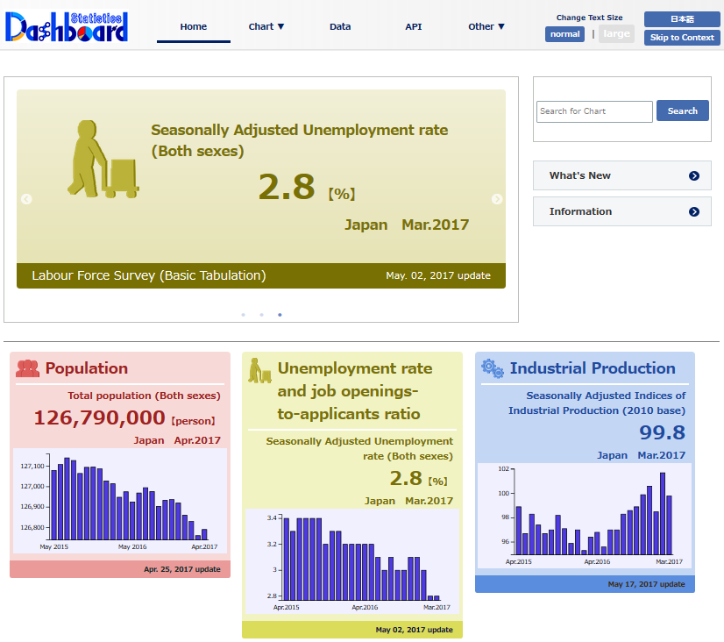
① Statistics Dashboard
Statistics Dashboard
Statistics Dashboard is a system that summarizes various statistical data and displays a set of graphs and charts based on the processed data
Example:
Top page of
the statistics dashboard
of one day
Notes:
This slide shows Statistics Dashboard for beginners.
In e-stat,
users needed to find, download and visualize their concerning macro data by themselves,
but using the statistics dashboard,
major statistics are processed into graphs and displayed in a list.
As shown in this screen,
Statistics Dashboard can display graphs of concerning time series
such as population and unemployment rate from the beginning.
I expect this service will contribute broadening the base of users of official statistics.

Slide 16
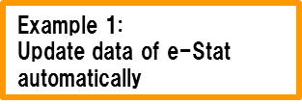

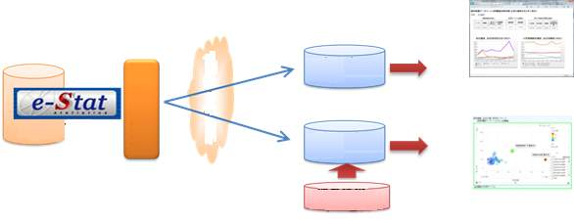




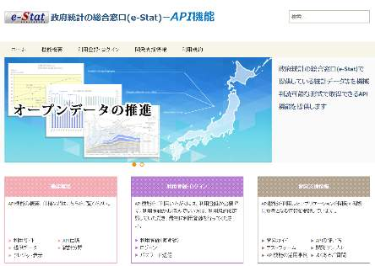



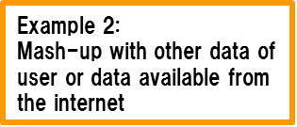
② API function & jSTAT MAP
Introduce API functions
API (Application Programming Interface) functions provide statistical data converted to machine readable data
Developer support information
is also available
Notes:
The e-stat is already equipped with these two kinds of outstanding services for its general users,
Application Programming Interface, API and Geographic Information System, named j-STAT MAP.
By Introducing API ,
users can retrieve official statistics data in a way that their computers can comprehend.
It means
macro data with user’s concern and their processing information are updated automatically in the user’s information systems.
I believe
the API will improve our user’s productivity of solution by big data and highly consistent with our new mission.

Slide 17
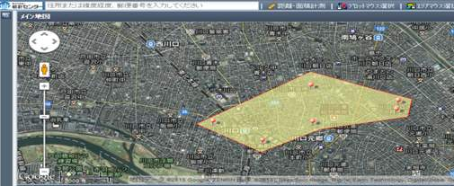
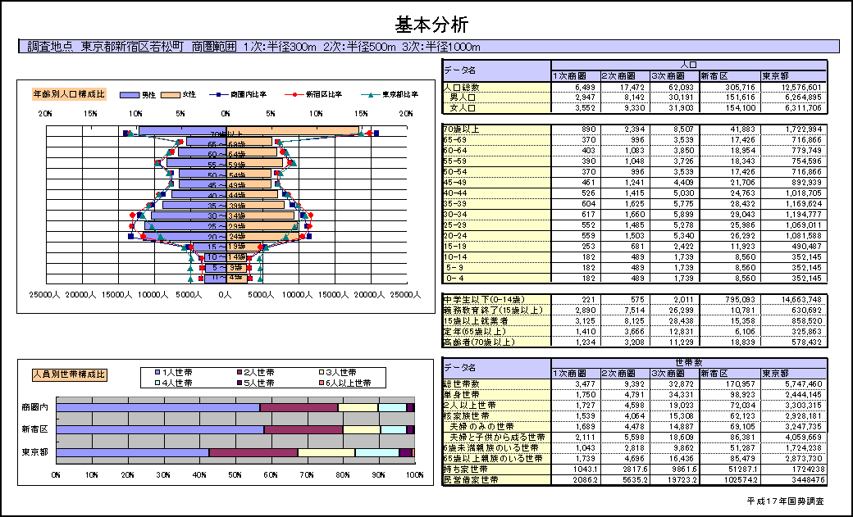
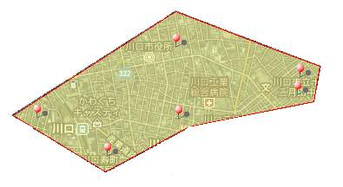
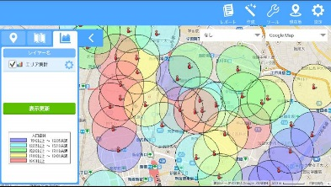


② API function & jSTAT MAP
Small area analytics on maps (jSTAT MAP)
Provide functions that enable users to tabulate statistics in any arbitrarily designated area and to import and tabulate any data owned by users
Data held by user
An App for Tablet is also available
Sales
Total
Man
Woman
Example 1:
The function enables retrieving various data held by data or making use of statistics data in an arbitrarily designated area
Example 2:
Prepare a report on the results of basic analysis including the age structure in the selected area
Notes:
The slide clarifies the user’s value from our new service,
jSTAT Map.
By using the this Geographic Information System,
users can do “Small area analytics on maps” easily by themselves.
For example,
if a user designate some small area on the map,
the system can immediately answer the total number of men, women, establishments, etc.in the area.
I expect jSTAT Map would also improve policy making or decision-making by the users.

Slide 18
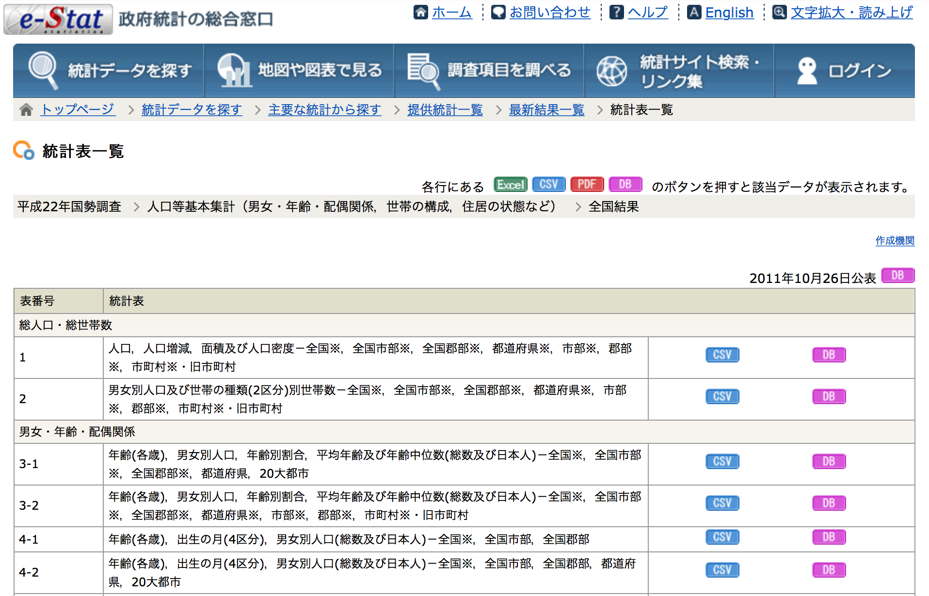
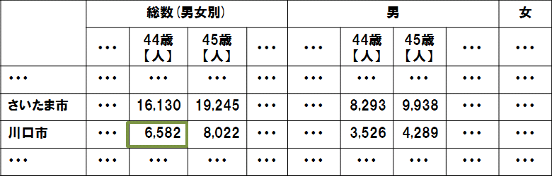
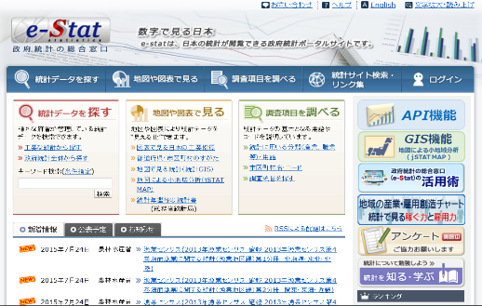



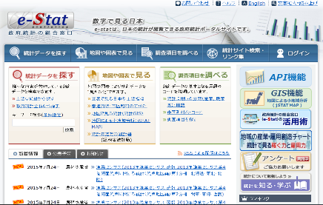
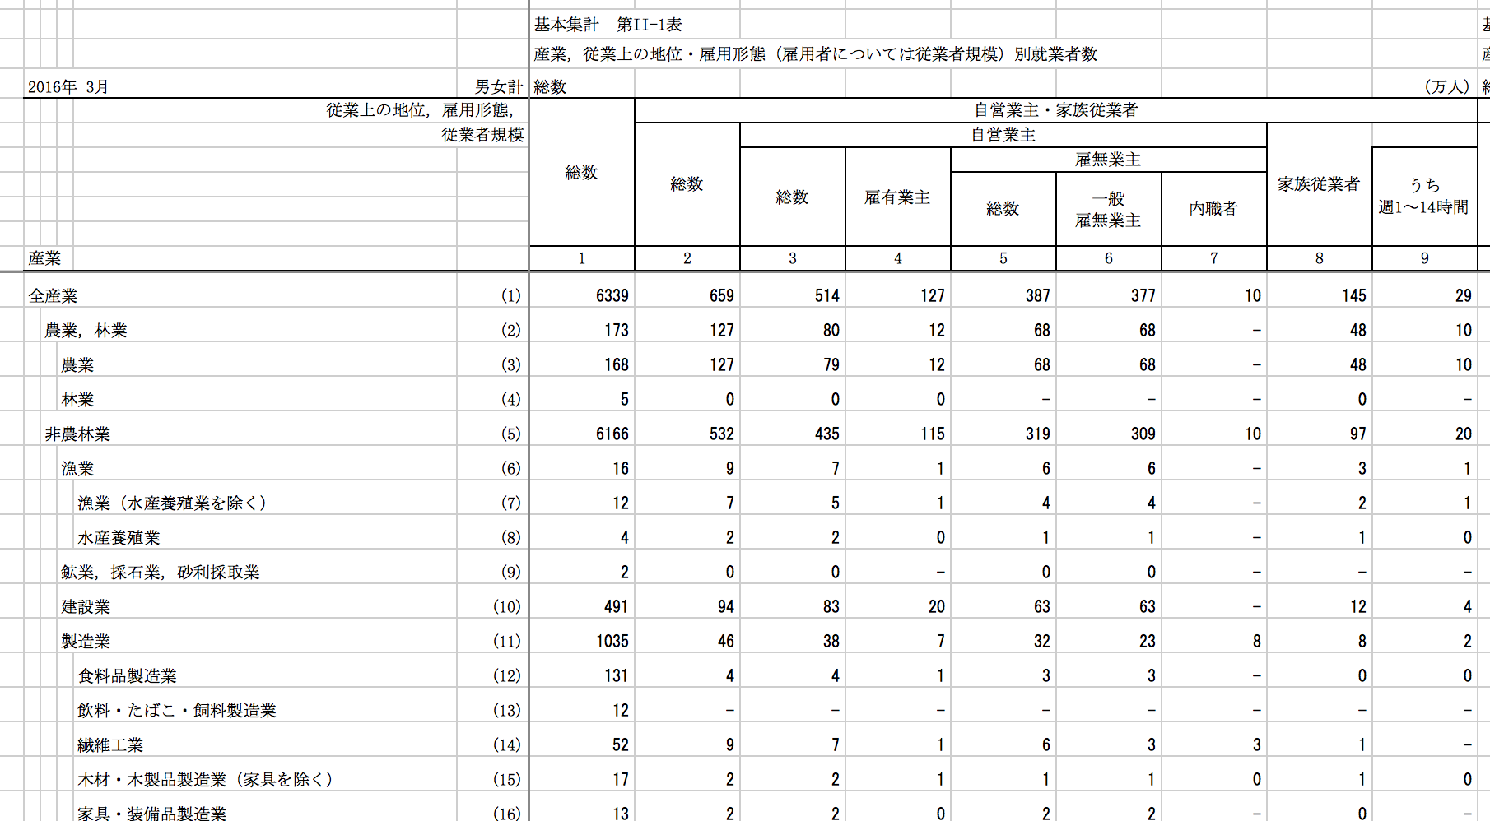
③ Statistical Linked Open Data
Statistical LOD - Five Levels of Open Data -
From link to files to link to data
Link to files
Link to data
Total Male Fem
Saitama
Kawaguchi
Addresses are given
to each file
(http://www.e-stat.go.jp/xls0001.xls)
Addresses are given to each data item
(http://data.e-stat.go.jp/lod/…/obs00001)
Wikipedia
Notes:
The slide summarizes role of statistical LOD for advanced users by showing what kind of information change occurs by attaching statistical LOD,
that is, advanced metadata to the macro data.
While previous meta data was provided by giving an address to each file,
the statistical LOD is provided by giving the address to each data unit.
This clarifies not only the meaning of each data,
but also clarifies the link possibility between data.

Slide 19
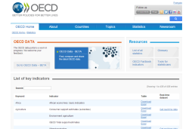
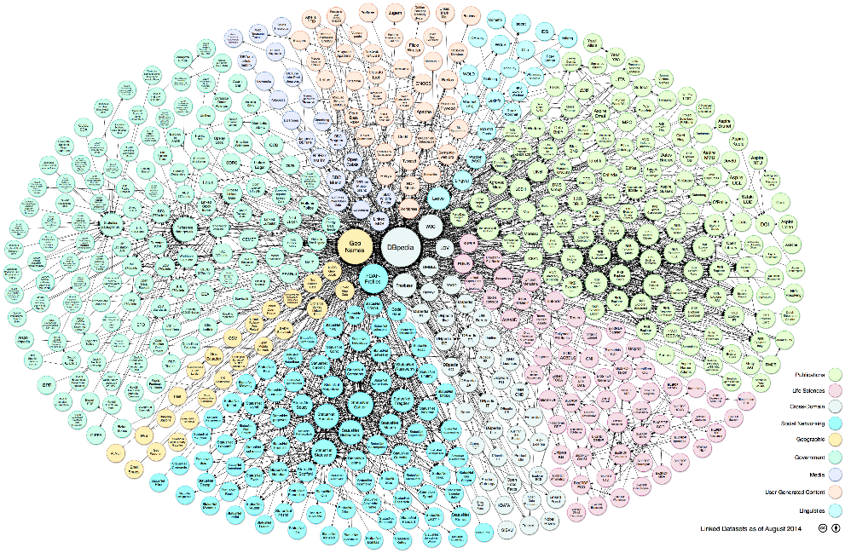
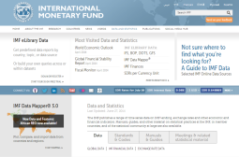

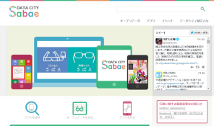
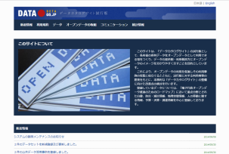
③ Statistical LOD
Applications will be standardized
Merits as LOD of statistical data
Defining data uniquely in the Internet by (URI), and expressing relationships by links.
Data are standardized
(Use of international standards (RDF^{※1}))
Links with other data
Access procedures are standardized.
(Use of international standards (SPARQL^{※2})
IMF
OECD
^{※1} RDF(Resource Description Framework ): A unified framework recommended by W3C (1999/02) (an international body which promotes to standardize techniques used on web.
^{※2} SPARQL: A language recommended by W3C (2008/01) to search RDF.
Local governments。
local public organization
Data catalog
Linking Open Data cloud diagram 2014, by Max Schmachtenberg, Christian Bizer, Anja Jentzsch and Richard Cyganiak. http://lod-cloud.net/ CC BY-SA
Notes:
One of the merits of LOD conversion is that the technology being used has been standardized internationally,
So it is expected that core data of the world will move toward LOD in the future.
In addition,
by making meaning of individual data clearly and logically,
self-integration between different data becomes much easier.
An information environment that facilitates integration of related data
shall be an important information base of the big data era.

Slide 20
2 Different Micro Data Provision
Provision of micro data by demand level of users
Types of microdata
Type of users & services
Level of
usage
requirement
③On-site use of statistical microdata
Researchers who want to analyze micro data deeper even with strict restriction.
Raw
data
②Provision of Anonymized data
Researchers who want to analyze micro data. Because anonymized micro data is provided with lower restrictions.
Anonymized data
①Release of microdata files for public use
Beginners, who want to know how to use micro data and want to analyze it simply and easily without any restriction.
Public use micro data
Range of users
Notes:
Because micro data contains personal information of the survey object,
extreme caution is required for its handling,
and its use has been restricted.
We think
Users, who want to have access to individual data are largely divided into three layers.
The top layer users are Advanced users,
who want to analyze using micro data themselves for detailed analysis even under some restrictions.
The second layer is for the users, who do not mind conducting analysis with anonymous micro data,
because they need to relax usage requirements to conduct more exploratory data analysis,
The third is Beginners,
who want to learn the data analysis method,
so, it does not matter even if the data for their analysis is not necessarily real micro data analysis.
For that reason,
we began planning the following three data provision services for each target.
The first service is provision of public use micro data for beginners
The second is providing anonymous data, for research
The third is Providing on-site usage service of micro data for highly publicized research led by public institutions
Let's explain individually from the next slide.

Slide 21
① Release of Public Use Microdata File
Public use microdata files
PUMF can be used freely as data for preliminary study as part of data science in statistics education or business without entailing difficulties related to the confidentiality of individual household information.
PUMF are not questionnaire information (microdata) itself, but simulative microdata which were randomly generated from the estimated correlation structure of the tabulated results.
Type of household | Record count | Contents of household attributes, etc. | Classification of income and expenditure number
All households | 45,811 | 7 items (3 major metropolitan areas or not, number of household members, number of earners, type of tenure of dwelling, characteristic of household head such as age(2 items), employment status) | 12 items (Yearly income, consumption expenditures, 10 major groups)
 |  |  | 422 items (Yearly income, consumption expenditures, 10 major groups, 410 items)
Worker's households | 26,239 | 4 items (characteristic of household head such as age, industry, occupation, size of enterprise) | Same as the above
Notes:
First, we will explain the provision of public use micro-data file, PUMF s for household consumption analyses.
Based on the distribution of published results of the nationwide consumption survey,
we create synthesized Public Use Microdata File from randomly generate pseudo data to reproduce the published results consistently.
This PUMF can be freely downloaded from our web page and its protection of personal information is unnecessary
because this PUMF is not actual micro data.
Analysis using this PUMF is not fit for academic empirical research
So PUMF is mainly for educators,
who teach data analysis to beginners or students.

Slide 22
② Provision of Anonymized data
Provision of Anonymized data
The anonymized data provision service aims to provide (lend) applicants who have applied for use of data with questionnaire data obtained from statistical surveys as anonymized data, which was processed so that no survey objects can be identified (anonymization processing: not only deleting information that allows for direct identification of individuals, such as name, but also categorizing information more broadly by integrating various detailed categories for regions and attributes, and deleting distinguishing data).
Survey Name | Time period
Population Census | 2000, 2005
Labour Force Survey | 1989～2012
Housing and Land Survey | 1993, 1998, 2003
National Survey of Family Income and Expenditure | 1989, 1994, 1999, 2004
Employment Status Survey | 1992, 1997, 2002, 2007
Survey on Time Use and Leisure Activities | QuestionnaireＡ 1991, 1996, 2001, 2006 QuestionnaireＢ 2001, 2006
Comprehensive Survey of Living Conditions | 1998, 2001, 2004, 2007, 2010
Notes:
For general researchers, "anonymized data“ sets have been provided.
This data was anonymized
so that the survey object is not specified for the micro data obtained from the statistical survey.
The anonymization process not only deletes information that can directly identify an individual such as a name,
but also deletes information such as regional divisions and details on various attributes
so that individuals are not indirectly identified during the users’ data analyses.
Our anonymous data set can be offered to academic researches, higher education etc in principle.

Slide 23
Example: Exploratory Data Analysis Using Anonymized Data:
Takebayashi, Y., Kubota, T. and Tsubaki, H. (2016) Risk profiles for severe mental health problem: classification and regression tree analysis, Proc. COMPSTAT 2016, pp.291-302.
Notes:
Now I’d like to show you our research using anonymized data of official statistics,
It is joint work of Dr. Takebayashi and Dr. Kubota Supported by Ministry of Health and Welfare.

Slide 24
Anonymized Micro Data from the Japanese National Comprehensive Survey of Living Conditions (2010)
Official Statistic by Ministry of Health, Labor and Welfare
health, medical care, welfare, pension, and income
n = 15901
Extracting High Suicidal Risk Groups
Psychiatric disorders: n = 259
Caregivers for relatives: n = 505
No Job : n = 550
Notes:
We utilized anonymized micro data from the 2010 Japanese National Comprehensive Survey of Living Condition by Ministry of Health, Labor and Welfer.

Slide 25
Outcome: Severe Psychological Distress Kesseer 6 (K6).
Analytical Datasets with K6 & Age ≧ 15 : n= 11239
Psychiatric disorders : n = 198
Caregiver: n = 304
No Job: n = 428
Notes:
Our outcome variable is K6

Slide 26
63 Potential Predictors for K6
Notes:
We selected 63 potential predictors or risk factors for K6 from the anonymized data set. the Japanese National Comprehensive Survey of Living Conditions (2010)

Slide 27
Classification Tree for Psychiatric disorders Group
One-person
Single-parent
Three generation

Slide 28
Classification Tree for Caregivers

Slide 29
Classification Tree for No Job

Slide 30
Predictor Variable Importance for K6

Slide 31
Comprehensive Exploratory Analyses of Micro Data from the Official Statistics
Although subjective stress factors are a commonly important factor in all three high risk groups, patterns of interaction between subjective stress and other factors to predict severe mental health difficulties differ greatly among mental health.
Not Anonymized but Original Microdata with Regional Information from Official Statistics such as “Japanese National Comprehensive Survey of Living Conditions” will be more Informative for Causal Analyses of Mental Health relevant with Suicides

Slide 32









③ On-site use of statistical microdata
Conceptual Diagram of on-site use utilizing remote access
Decides on permission for application for use and taking data
National government offices and ministries
(survey conductors, such as SBJ)
Service counter
Formality check of application for use, and formality examination of taking data
Management of the data and system, etc.
Registration for the questionnaire information.
Entrusts necessary related business, such as service counter, to NSTAC.
Dedicated servers
On-site facilities
On-site facilities
SINET
(Uses the VPN service)
National
Statistics Center
Virtual PCs
Administrator
Operates virtual PCs
by remote control
(Central-data-management facilities)
Users
Displays the tabulated/analysis results.
(Using memory equipment, such as a USB memory stick, is prohibited and it cannot be used.)
Users
Monitoring camera
↓
On-site facilities
Formality examination is conducted when taking data
On-site facilities
Notes:
Next is the service of providing a micro data analysis environment for advanced users.
Even now,
micro data can be partly provided with strict conditions in case of a research with high public utility,
but the information that can be provided is limited only to the part necessary for the reported research plan.
Unfortunately,
researchers can not do creative data analysis at all under these strict constraints.
Therefore,
we decided to provide researchers with on-site use of our micro data utilizing remote access to the national statistic center
that enables creative micro data analysis with secure environment.
In January 2017,
an onsite facility was installed at the national statistics center and functional verification started and in April 2018 a new center for managing and accelerating application of statistical microdata to social researches was established in Wakayama prefecture. a
Full-scale operation started since May 2019.
Currently, on-site facilities are set up at 12 universities and organizations in Japan.

Slide 33







③ On-site use of statistical microdata
Merits of on-site use
Present (provide with DVD)
Future (on-site use)
Use condition
It must be the use of microdata in research deemed to provide a public-benefit.
Use condition
It must be the use of microdata in research deemed to provide a public-benefit.
Researchers are responsible for ensuring security at large.
Facility installation personnel are responsible
for ensuring a secure environment.
Security
Security
User needs to obtain permission by submitting an application for use including the detailed design of tabulation and analysis.
User burden is reduced by simplifying the application for use.
Appli-cation
Appli-cation
Micro-
data
Only the minimum information required for the designed analysis is provided.
Micro-
data
All the information is available for use.
Exploratory and creative research is difficult.
Exploratory and creative research is possible.
Notes:
By setting up this onsite facility,
it will greatly improve researcher's convenience.
Until now,
it was necessary to decide the contents of data analysis in advance.
However, in on-site facility use, there is no need to do it.
It is possible to perform creative data analysis using all the information of the micro data,
while downloading micro data from onsite facilities is systematically impossible.
So our information security will be greatly improved by the on-site facilities.
since so far raw data itself has been provided directly to a researcher on DVD even with strict restrictions.

Slide 34
Ⅳ What we can do in the Onsite Facilities: Example 1
Aggregation not by the 47 Prefectures but by the 1506 Municipalities in Japan using the 2016 Survey on Time and Leisure Activities
Notes:
I will show you 2 examples utilizing the onsite facility in the Institute of Statistical mathematics to illustrate two merits of the micro data analyses in an onsite facility. First example is very simple. We can aggregate several variables by municipality in Japan only in the onsite facilities.
In fact the Bureau of Statistics has published statistics compiled by prefecture, but has not published aggregated values by municipality due to lack of accuracy in case of sample surveys as Survey on Time and Leisure Activities In fact the # of municipality is 1741 in Japan but I can aggregate only 1506 municipalities by using 2016 Survey on Time and Leisure Activities , because some of municipalities have not been sampled as study areas in case of 2016 Survey on Time and Leisure Activities. But we can clarify the between municipality variation of the time spent different activities such as total time spent alone, time spent caring and nursing, Time spent caring and nursing alone, etc.

Slide 35
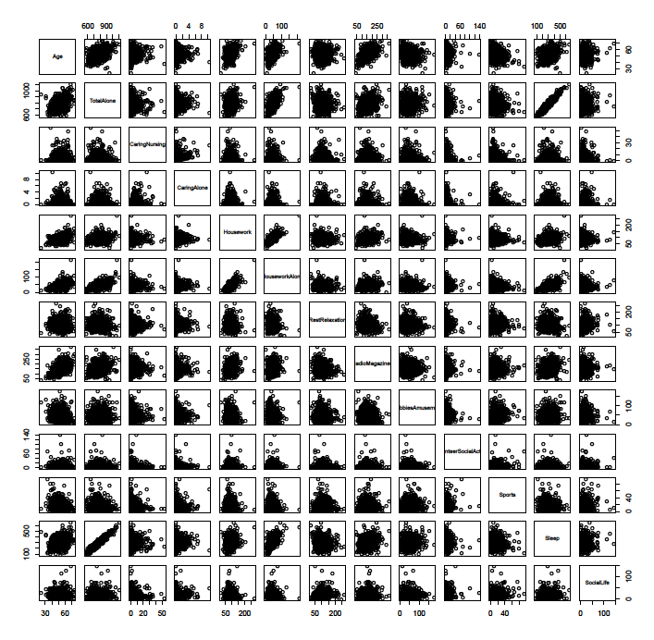
Scatter Plot Matrix
Notes:
This is the scatter plot matrix of time spent different activities. Of course this example is merely simple description of data not exploratpry data analysis.

Slide 36
Example 2 Exploratory Data Analysis in an Onsite Facility
Analyzing Micro-data of the 2016 Survey on Time and Leisure Activities
[Objective variable ]
The time spent to care for family members during one day
[Explanatory variables]
Micro Data
Employment situation, household income
Gender, age, relationship with the head of the family, marriage situation
Work, schoolwork, wasted time to commute to work or school
Obtaining days off from caregiving, days of the week when caregiving is done
Use of external services related to caregiving
Age of the person requiring care
Caregiving at home (or living apart, admission into a caregiving facility or hospital)
Macro Data Aggregated by Municipality
Population of each municipality
Environmental Variables Per Population
household, the natural environment, economic foundation, administrative foundation, education environment, culture and sports, residences, health and medical care, welfare and social security, etc.
37
Notes:
The next example shows exploratory data analysis, objective variable is microdata of the time spent to care for family members during one day.
In terms of explanatory variables, We linked the micro data of the 2016 Survey on Time and Leisure activities with the macro data of public statistics aggregated by municiparity.

Slide 37

Objective variable: The time spent to care for family members
n=37,060
(People who have family members who require care )
Less
than
More
than
Age
24.5 min.
Time for caregiving, 24 minutes on average
If the cared person is over 65→ 48.1 min
43.2
Part-time,
unemployed
Full time
Work
The prefectures repeatedly make nodes
0.3
27.0
66.2
External
services
Days off for caregiving
25.6
206.0
56.0
107.0
Less than / More than 3.5 days a week
Prefecture
Prefecture
Prefecture
Prefecture
Prefecture
Prefecture
Prefecture
*The headings with outputs of less then 10 people were manually halted.
Notes:
We applied the Breiman’s regression tree to the dataset and got the optimum stratification results like this automatically

Slide 38
One of the scenarios where caregiving time
dramatically increases
Micro: Part time job or Unemployed
Macro:Prefecture(Hokkaido,Iwate,Tochigi,Saitama,Tokyo, Kanagawa,Ishikawa,Nagano,Gifu,Mie,Osaka,Hyogo,Okayama,Hiroshima,Tokushima,Kochi)9 f)
Macro: Number of children going to nurseries in residential municipalities: More than 0.032 people/population
Macro: Population of women not in the workforce: Less than 0.16 people/population
Macro: Employees in a secondary industry: More than 0.087 people/population
Micro: Use of external services for caregiving: 4~5 days a week
Macro: Number of hospital/population
More than 0.0000191 hospitals→ 85.2 minutes
Less than 0.0000191 hospitals→ 303.8 minutes

Slide 39
Ⅴ Conclusion
Big Data Era is requiring from statistics agencies both new data and human resources for new value creation.
Official statistics agencies should make their best efforts to realize the true value co-creation with their users
Notes:
Finally I will conclude my presentation with two messages.
Big data era is requiring us both new data and human resources for new value creation.
We should make our best effort to realize the true value co-creation with our users.

